Slide 1

Introduction to Machine Learning Topic 8 – Clustering (HOML Ch. 9 / ISL Ch.10)
Master in Quantitative Economic Analysis MQuEA
Javier Bas
Universidad Autónoma de Madrid
2022/2023

Slide 2
Outline
Clustering
K-means clustering
Elbow
Silhouette
Limitations
Hierarchical clustering
K-means and Hierarchical clustering additional considerations
Other clustering methods
Master in Quantitative Economic Analysis MQuEA
Universidad Autónoma de Madrid

Slide 3
Clustering
Clustering refers to a broad set of techniques for finding subgroups in a data set.
We seek to partition the observations into distinct groups so the observations in each group are similar to each other (homogeneus), while observations in different groups, are different from each other.
Probably, the key question is what similar means?
Master in Quantitative Economic Analysis MQuEA
Universidad Autónoma de Madrid

Slide 4
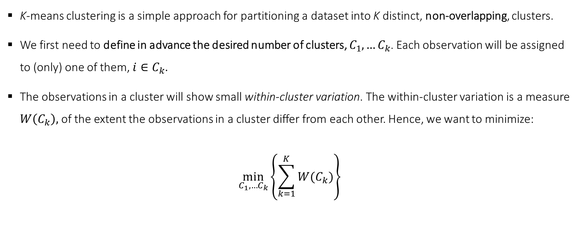
K-means clustering
K-means clustering is a simple approach for partitioning a dataset into K distinct, non-overlapping, clusters.
We first need to define in advance the desired number of clusters, $C_{1},…C_{k}$. Each observation will be assigned to (only) one of them, $i∈C_{k}$.
The observations in a cluster will show small within-cluster variation. The within-cluster variation is a measure $W\left(C_{k}\right),$ of the extent the observations in a cluster differ from each other. Hence, we want to minimize:
$$\min_{C_{1},…C_{k}}\left\{\sum_{k=1}^{K}{W(C_{k})}\right\}$$
Master in Quantitative Economic Analysis MQuEA
Universidad Autónoma de Madrid

Slide 5
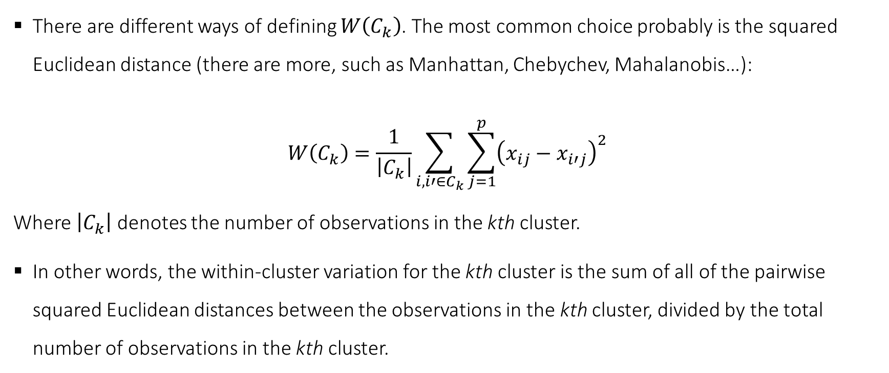
K-means clustering
There are different ways of defining $W\left(C_{k}\right)$. The most common choice probably is the squared Euclidean distance (there are more, such as Manhattan, Chebychev, Mahalanobis…):
$$W\left(C_{k}\right)=\frac{1}{\left|C_{k}\right|}\sum_{i,i′∈C_{k}}{\sum_{j=1}^{p}{{\left(x_{ij}−x_{i′j}\right)}^{2}}}$$
Where $\left|C_{k}\right|$ denotes the number of observations in the kth cluster.
In other words, the within-cluster variation for the kth cluster is the sum of all of the pairwise squared Euclidean distances between the observations in the kth cluster, divided by the total number of observations in the kth cluster.
Master in Quantitative Economic Analysis MQuEA
Universidad Autónoma de Madrid

Slide 6
K-means clustering
The algorithm assigns each observation to a class, minimizing the within-cluster variation, as follows:
Randomly assign a number from 1 to K, to each observation. These are the initial cluster assignments.
Iterate until cluster stops changing:
For each K cluster, compute its centroid. The centroid is the vector of the p features means for the observations in the kth cluster
Re-assign each observation to the cluster whose centroid is closest (in terms of Euclidean distance)
A visualization: https://www.naftaliharris.com/blog/visualizing-k-means-clustering/
Master in Quantitative Economic Analysis MQuEA
Universidad Autónoma de Madrid

Slide 7
K-means clustering
K-means is guaranteed to converge, to find a solution. Although it may not be global (not the best one but a local optimum).
The algorithm is sensitive to the first random initialization. We can mitigate this by:
If we happen to know approximately where the centroids should be, we can indicate them using the init hyperparameter
Run the algorithm several times, using the n_init hyperparameter (be carefull, their names are similar)
By default, sklearn uses n_init = 10, keeping the best solution. The best solution is that with the lowest inertia.
Inertia is the mean squared distance between each instance and its closest centroid.
Master in Quantitative Economic Analysis MQuEA
Universidad Autónoma de Madrid

Slide 8
K-means clustering – Elbow method
K-means require to define a priori the number of clusters… but how can we know in advance?
We can’t. We need to explore a range of number of clusters and pick up one.
It is tempting to chose the one with the lowest inertia. However, inertia always goes down as the number of clusters increase (obviously, the more clusters there are, the closer each instance would be to its centroid).
However, the contribution of an additional cluster to the goodness-of-fit diminishes as clusters increase. Hence, we only need to choose the one for which the next does not add much to the reduction of inertia.
Master in Quantitative Economic Analysis MQuEA
Universidad Autónoma de Madrid

Slide 9
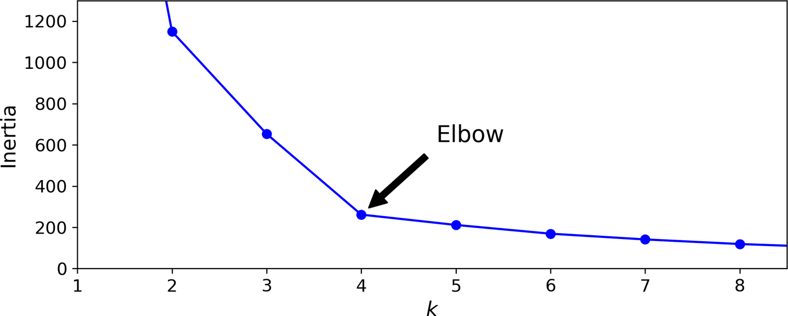
K-means clustering – Elbow method
Master in Quantitative Economic Analysis MQuEA
Universidad Autónoma de Madrid

Slide 10
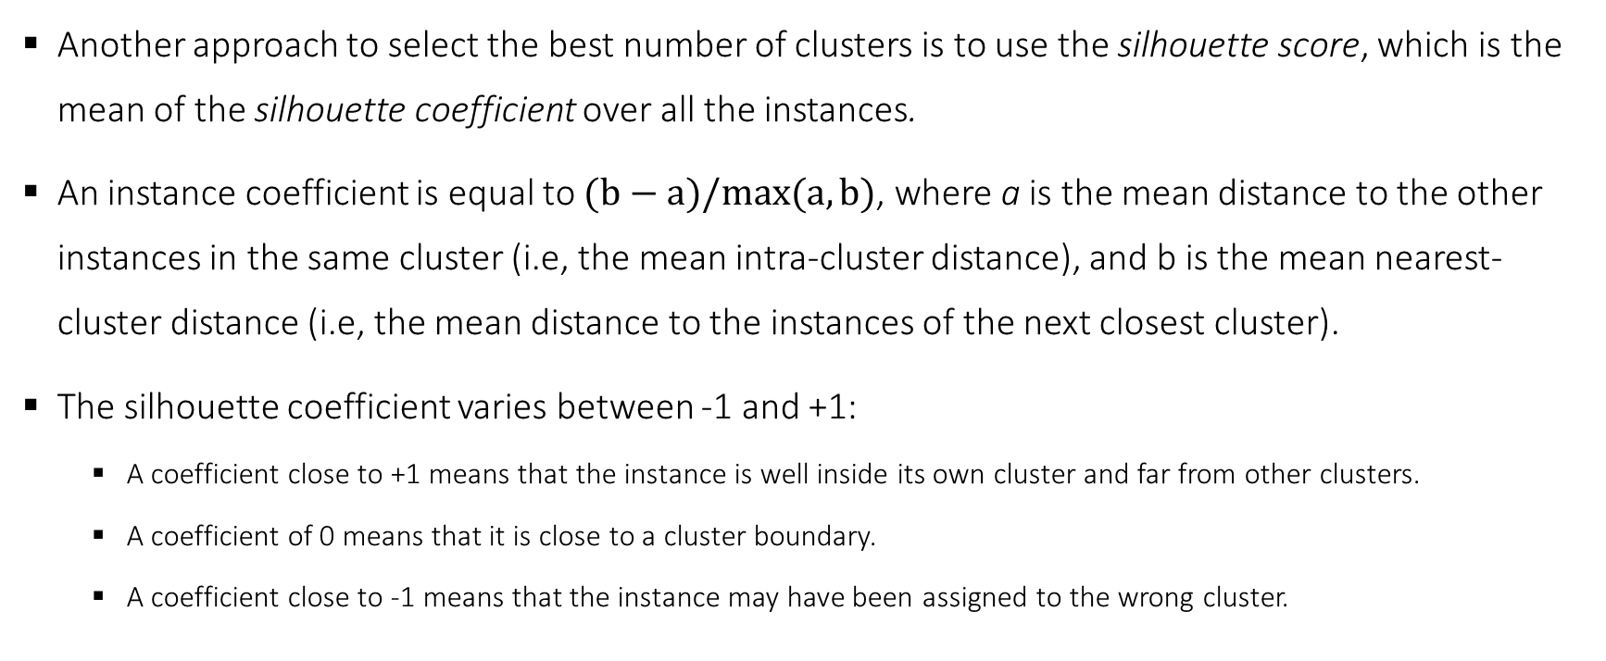
K-means clustering - Silhouette
Another approach to select the best number of clusters is to use the silhouette score, which is the mean of the silhouette coefficient over all the instances.
An instance coefficient is equal to $(b−a)/max⁡(a,b)$, where a is the mean distance to the other instances in the same cluster (i.e, the mean intra-cluster distance), and b is the mean nearest-cluster distance (i.e, the mean distance to the instances of the next closest cluster).
The silhouette coefficient varies between -1 and +1:
A coefficient close to +1 means that the instance is well inside its own cluster and far from other clusters.
A coefficient of 0 means that it is close to a cluster boundary.
A coefficient close to -1 means that the instance may have been assigned to the wrong cluster.
Master in Quantitative Economic Analysis MQuEA
Universidad Autónoma de Madrid

Slide 11
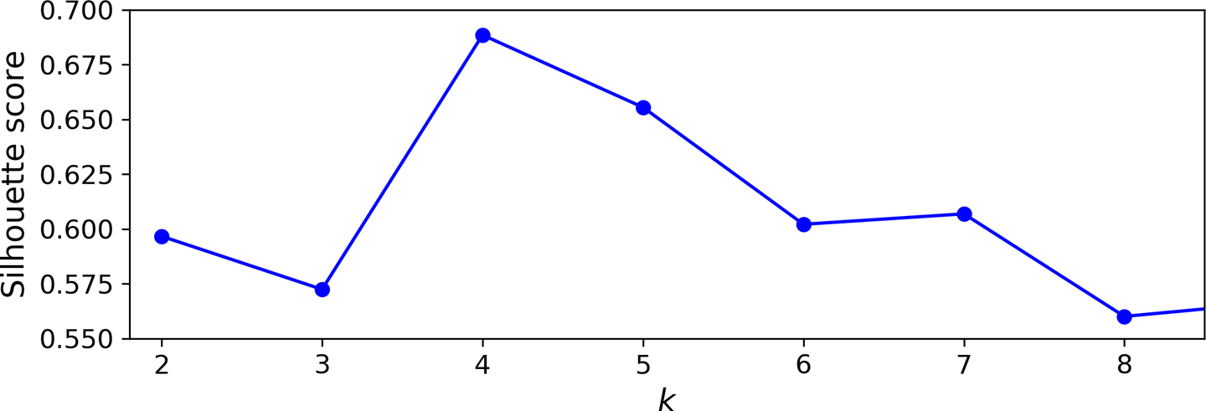
K-means clustering - Silhouette
Remember:
Silhouette score is the mean
of the score among all obs
Master in Quantitative Economic Analysis MQuEA
Universidad Autónoma de Madrid

Slide 12
K-means clustering - Silhouette
Even more informative is plotting every instance’s silhouette coefficient, sorted by the cluster they are assigned to and by the value of the coefficient. This is called a silhouette diagram.
The diagram contains one knife shape per cluster. The shape’s height indicates the number of instances the cluster contains. The width represents the sorted silhouette coefficients of the instances in the cluster. The dashed line indicates the mean silhouette coefficient.
Master in Quantitative Economic Analysis MQuEA
Universidad Autónoma de Madrid

Slide 13
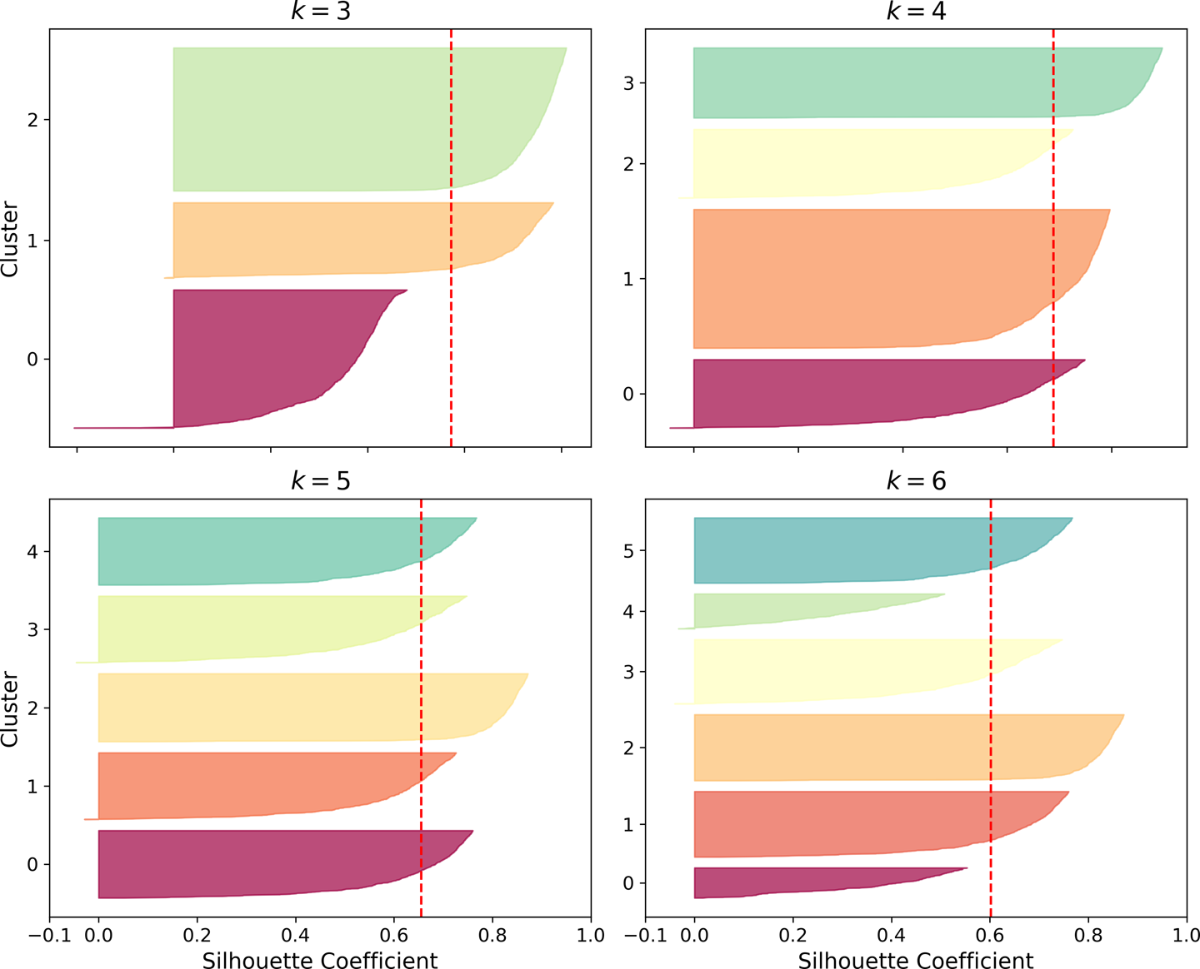
K-means clustering - Silhouette
Master in Quantitative Economic Analysis MQuEA
Universidad Autónoma de Madrid

Slide 14
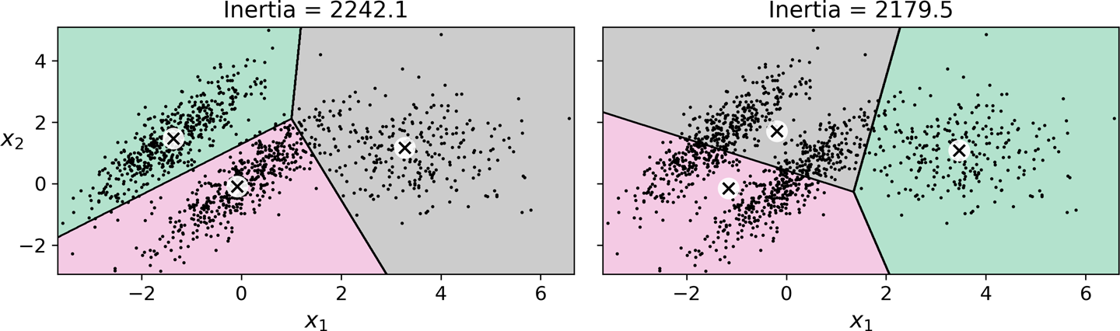
K-means clustering - Limits
Although K-means has its advantages (fast and scalable), it also counts with notable drawbacks:
It is necessary to run the algorithm several times to avoid suboptimal solutions.
We need to specify the number of clusters, which can be quite a hassle.
K-means do not behave well when the clusters have varying sizes, different densities or non-spherical shapes.
Lowest inertia but even worst classification
On this type of elliptical clusters, Gaussian mixture models work better
Master in Quantitative Economic Analysis MQuEA
Universidad Autónoma de Madrid

Slide 15
Hierarchical clustering
Hierarchical clustering is a technique that does not require to specify in advance the number of clusters. It also provides a tree-based representation of the clusters called dendrogram.
The most common type of hierarchical clustering is the Agglomerative clustering. The dendrogram is built starting from the leaves and combining clusters up to the trunk.
The algorithm starts by considering each observation as its own cluster. Then it computes a similarity measure (Euclidean distance, for instance) and merges observations based on it.
Concretely, it fuses the two most similar to each other, so now there are n-1 clusters. The next two clusters that are most similar are fused again, and so on, until all observations pertain to one only cluster.
Master in Quantitative Economic Analysis MQuEA
Universidad Autónoma de Madrid

Slide 16
Hierarchical clustering
Clusters painted in colors for you. The algorithm don´t know the classification (because it doesn´t exist)
linkage method (a measure of similarity: complete, single, average, centroid)
Master in Quantitative Economic Analysis MQuEA
Universidad Autónoma de Madrid

Slide 17
Other clustering methods
DBSCAN: Defines clusters as continuous regions of high density. This is, if there are regions with no data, and other regions with a high concentration of data.
BIRCH: Suitable for very large datasets with just a few features.
Mean-shift: Groups observations in circles of high density. Not suitable for large datasets.
Affinity propagation: Uses a voting system. Not suitable for large datasets.
Spectral clustering: Applies a dimensionality reduction and then applies another clustering algorithm to that space.
Gaussian mixture: Appropriate for ellipsoidal clusters
Master in Quantitative Economic Analysis MQuEA
Universidad Autónoma de Madrid

